Slide 1
HOSTEL OUTPASS Management System
By-
Manvi Agarwal

Slide 2
INTRODUCTION
The Hostel Outpass Management System, is an application that will help Hostlers, Management and Parents to keep a record of the Student’s movement. It helps Management to manage the student flow by issuing them the online Outpass to move across the flap gates and generate movement reports, among other things.

Slide 3
PROBLEMS FACED
Hostel being the second home for students require security to be the topmost priority.
Travelling of students from hostel to other places require a good management system to ensure their presence in and out the hostel.
The problem arises when the intake of students in the hostel increases exponentially.
Thus managing the student outpass’s manually becomes hectic.

Slide 4
APPROACH
The objective of this project is to develop a Hostel Outpass Management System which will reduce the manual work and automate the process.
Moreover, the parents will be in loop during the outstay of students.
The track record of students is maintained to help faculties and parents to manage the activities of their wards.

Slide 5
Students will be provided with a login wherein they will enter the outlook id, registration no. and password.
After login they will enter their respective outpass details.
Then parents will receive an otp for the outpass activation.
After parents approval, it will be directed to the warden for confirmation.

Slide 6
Constraints
The proposed system will store the crucial and sensitive student’s information thus dealing with the matter of safety and security of students.
Thus it is vital to keep the safety and security of students as our topmost priority.
To ensure the above criteria we tend use high end security measures.

Slide 7
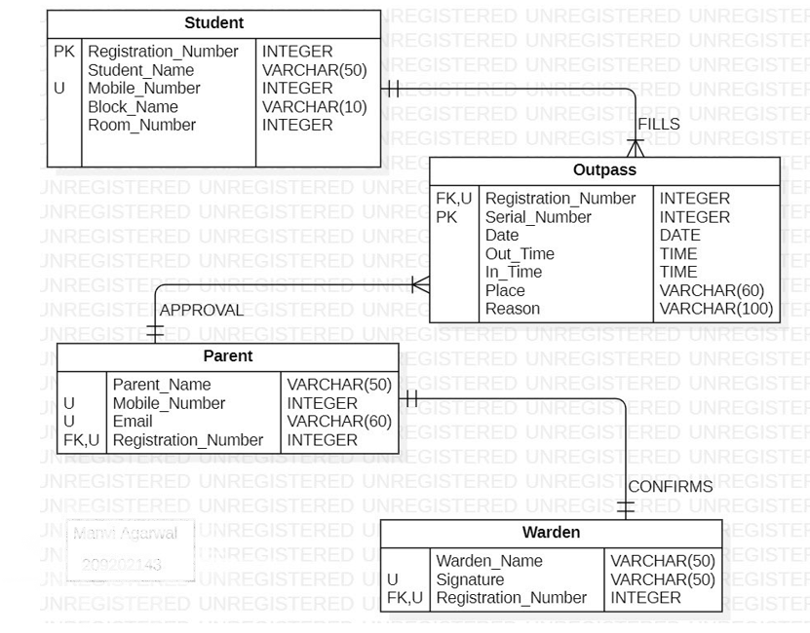
ER-DIAGRAM

Slide 8
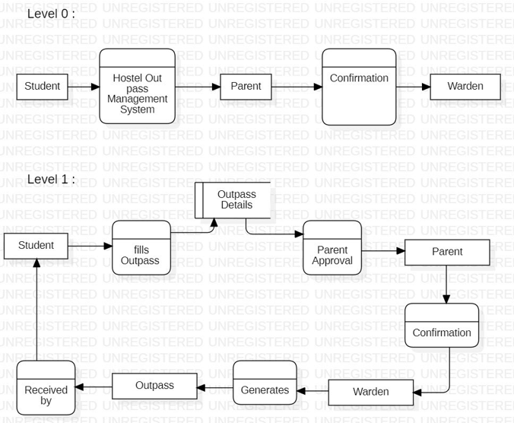
DATA FLOW DIAGRAM

Slide 9
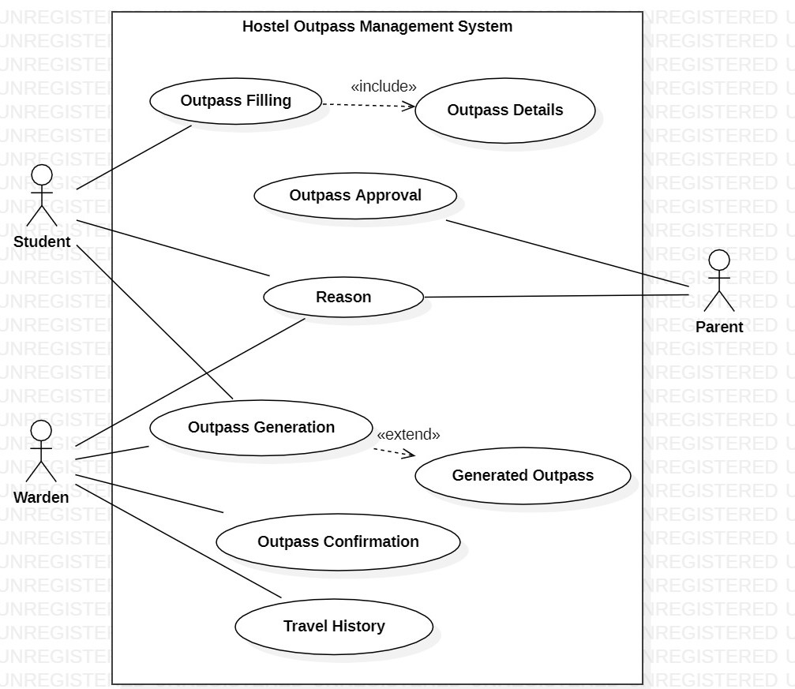
USE CASE DIAGRAM

Slide 10
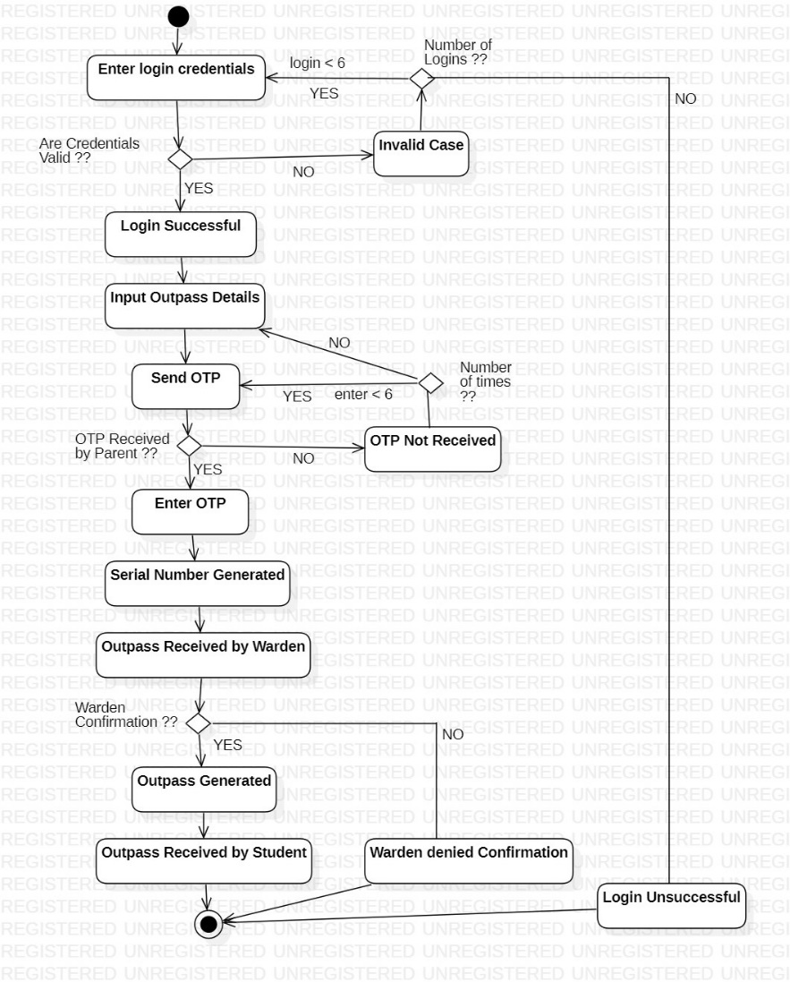
ACTIVITY DIAGRAM

Slide 11
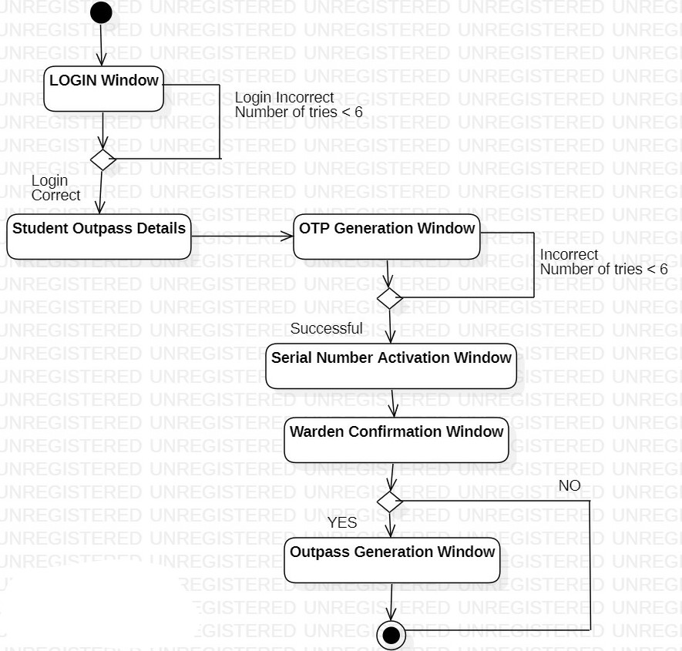
STATE DIAGRAM

Slide 12
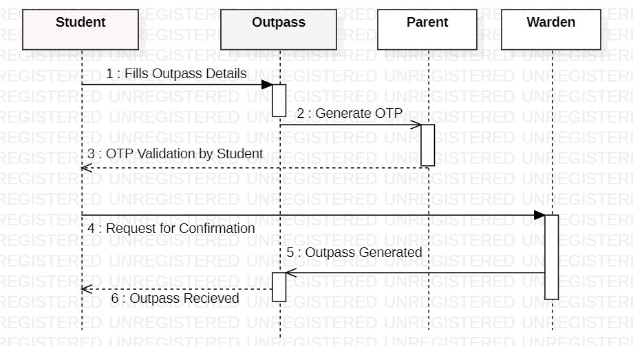
SEQUENCE DIAGRAM

Slide 13
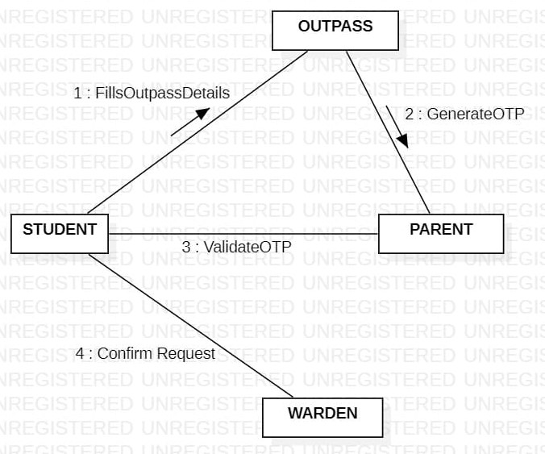
COLLABORATION DIAGRAM

Slide 14
CONCLUSION
Thus we conclude that Hostel Outpass Management System is beneficial in keeping the travel record of the hostlers and enabling an easy digital way of assigning the outpass’s based on parent’s approval and warden’s confirmation.
Specially when the intake of students is exponentially high.

Slide 15
THANK YOU

